Slide 1

Presentation Topic Energy, Water, Environment Sustainability
Student Name, Batch, Roll No., PRN,
Student official (VIIT) mail Id
Department of Engineering & Applied Science
BRACT’S, Vishwakarma Institute of Information Technology, Pune-48
(An Autonomous Institute affiliated to Savitribai Phule Pune University)
(NBA and NAAC accredited, ISO 9001:2015 certified)

Slide 2
Introduction of Koyna Hydroelectric Power Plant
Hydro Electric power (HEP) is a major renewable energy source used all over the world today to produce electricity. It utilizes the basic laws of Physics. Falling water under high pressure has high kinetic energy. In an HEP station, the falling water turns the turbines. Through magnetic induction, the generator converts the mechanical energy of the turbines to electricity.
The most common type of hydroelectric power plant is an impoundment facility. An impoundment facility, typically a large hydropower system, uses a dam to store river water in a reservoir. Water released from the reservoir flows through a turbine, spinning it, which in turn activates a generator to produce electricity.
Student’s Name, Department of Engineering and Applied Sciences, VIIT, Pune-48

Slide 3
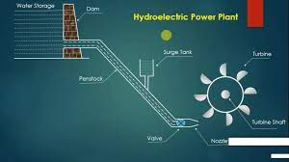
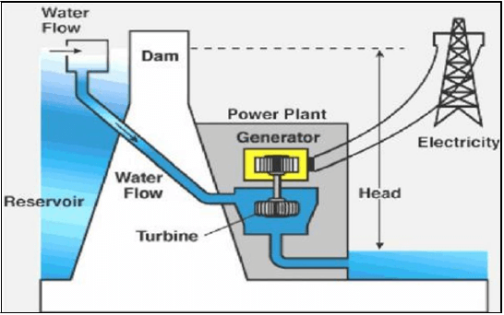
Principle of Hydroelectric Power Plant
The working principle of the hydroelectric power plant is that it converts the potential energy (due to the elevation of water from the channel) and the kinetic energy (due to fast-flowing water) of the water into mechanical energy with the help of turbines.
Student’s Name, Department of Engineering and Applied Sciences, VIIT, Pune-48

Slide 4
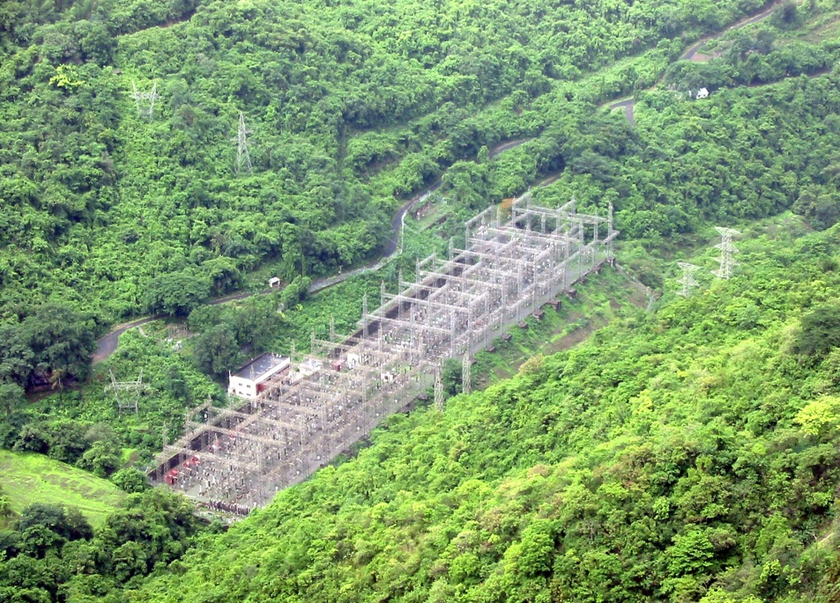
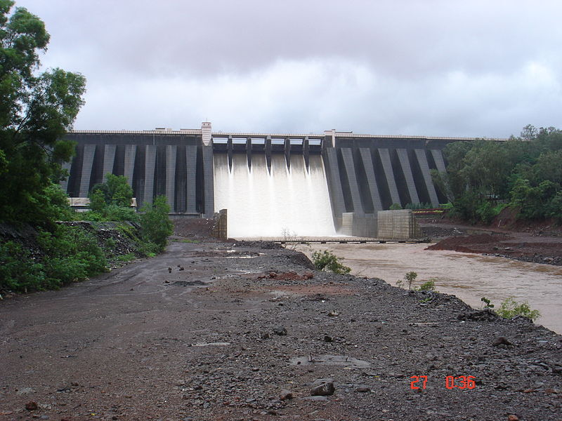
Photographs of Koyna Dam Hydroelectric Power Plant
Student’s Name, Department of Engineering and Applied Sciences, VIIT, Pune-48

Slide 5
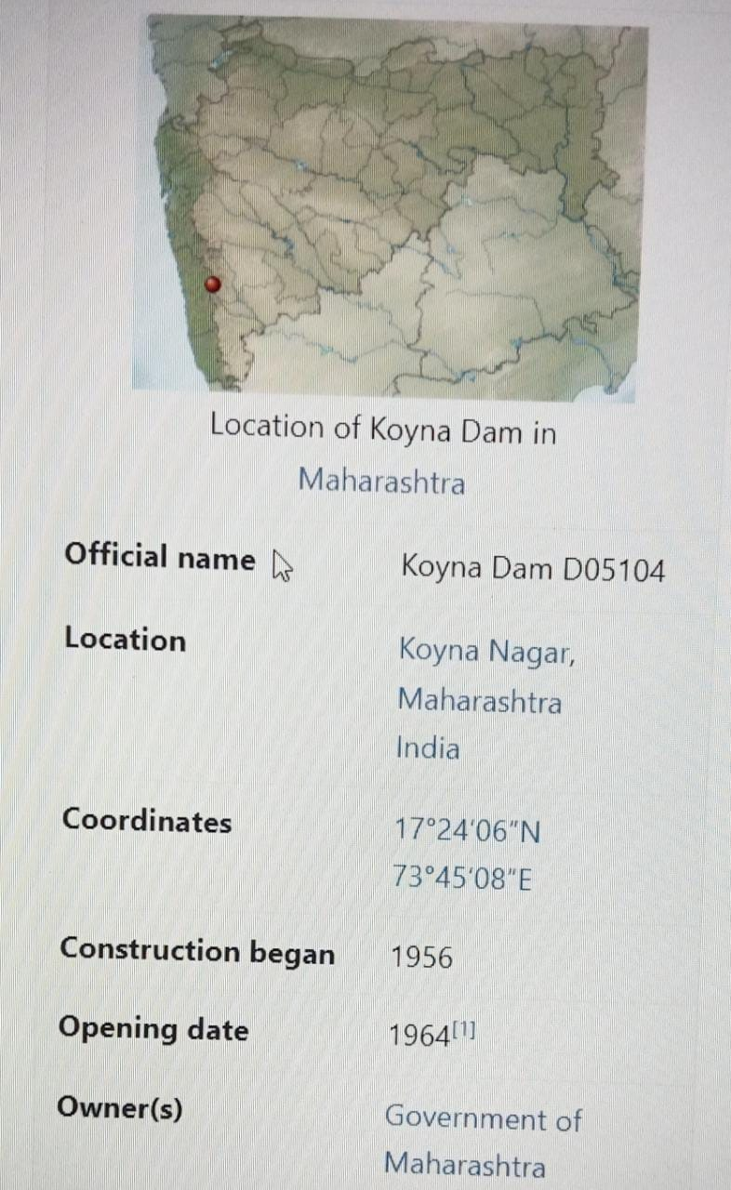
The main purpose of the dam is hydroelectricity with some irrigation in neighboring areas. Today the Koyna Hydroelectric Project is the largest completed hydroelectric power plant in India having a total installed capacity of 1,960 MW. Due to its electricity generating potential Koyna river is considered as the 'life line of Maharashtra’.
The spillway of the dam is located at the center. It has 6 radial gates. The dam plays a vital role of flood controlling in monsoon season. The catchment area dams the Koyna river and forms the Shivasagar Lake which is approximately 50 km (31 mi) in length. It is one of the largest civil engineering projects commissioned after Indian independence. The Koyna hydro-electric project is run by the Maharashtra State Electricity Board.
Student’s Name, Department of Engineering and Applied Sciences, VIIT, Pune-48

Slide 6
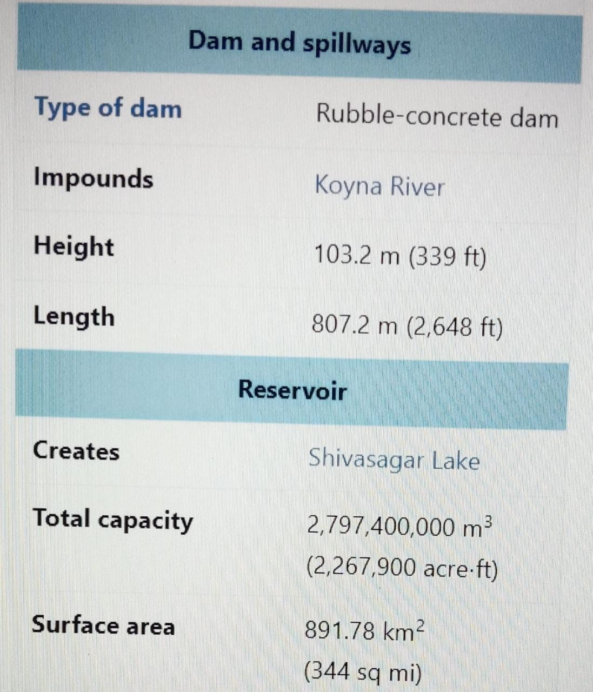
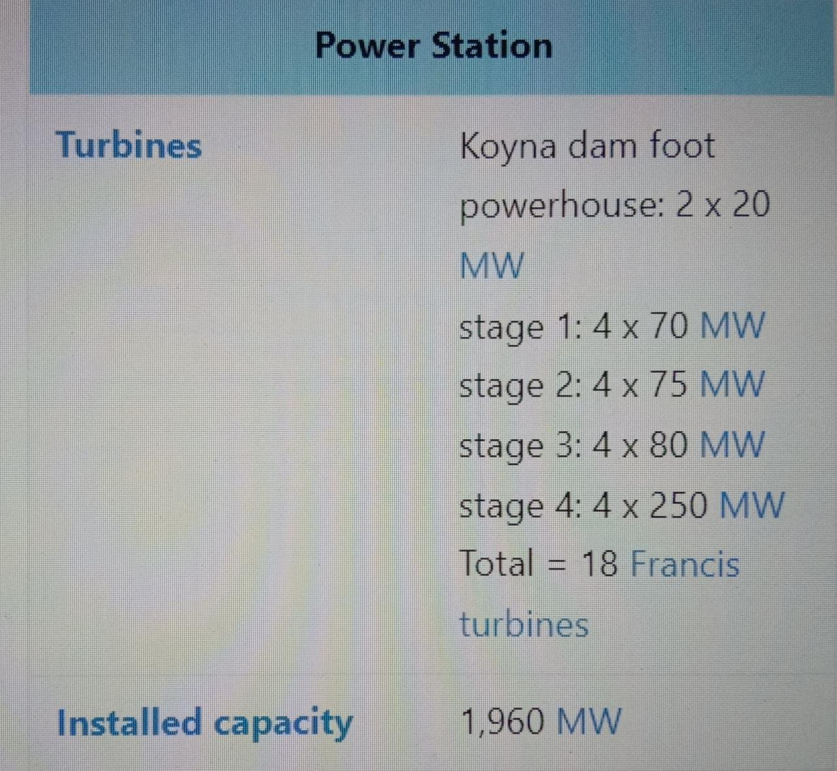
Hydroelectric Power Plant
Student’s Name, Department of Engineering and Applied Sciences, VIIT, Pune-48

Slide 7
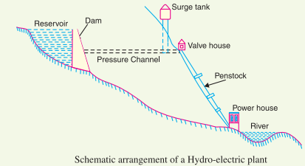
Schematic Diagram of Hydroelectric Power Plant
Although a hydro electric power station simply involves the conversion of hydraulic energy into electrical energy. The dam is constructed across a river or lake and water from the catchment area collects at the back of the dam to form a reservoir. A pressure tunnel is taken off from the reservoir and water brought to the valve house at the start of the penstock. The valve house contains main sluice valves and automatic isolating valves. The former controls the water flow to the power house and the latter cuts off the supply of water when the penstock bursts. From the valve house, water is taken to water turbine through a huge steel pipe known as penstock. The water turbine converts hydraulic energy into mechanical energy. The turbine drives the alternator which converts mechanical energy into electrical energy.
A surge tank (open from top) is built just before the valve house and protects the penstock from bursting in case the turbine gates suddenly closed due to electrical load being thrown off. When the gates close, there is a sudden stopping of water at the lower end of the penstock and consequently, he penstock can burst like a paper log. The surge tank absorbs this pressure swing by increase in its level of water.
Student’s Name, Department of Engineering and Applied Sciences, VIIT, Pune-48

Slide 8
Working of Hydroelectric Power Plant
The constituents of a hydro electric plant are
(1) Hydraulic structures
(2) Water turbines and
(3) Electrical equipment
1. Hydraulic structures : Hydraulic structures in a hydro electric power station include dam, spillways, headworks, surge tank, penstock and accessory works.
(I) Dam : A dam is a barrier which stores water and creates water head. Dams are built of concrete or stone masonry, earth or rock fill. The type and arrangement depends upon the topography of the site.
(ii) Spillways : There are times when the river flow exceeds the storage capacity of the reservoir. Such a situation arises during heavy rainfall in the catchment area. In order to discharge the surplus water from the storage reservoir into the river on the down-stream side of the dam, spillways are used.
(iii) Headworks : The headworks consists of the diversion structures at the head of an intake. They generally include booms and racks for diverting floating debris, sluices for by-passing debris and sediments and valves for controlling the flow of water to the turbine
(iv) Surge tank : Open conduits leading water to the turbine require no protection. However, when closed conduits are used, protection becomes necessary to limit the abnormal pressure in the conduit. For this reason, closed conduits are always provided with a surge tank. A surge tank is a small reservoir or tank (open at the top) in which water level rises or falls to reduce the pressure swings in the conduit.
(v) Penstocks : Penstocks are open or closed conduits which carry water to the turbines.
Student’s Name, Department of Engineering and Applied Sciences, VIIT, Pune-48

Slide 9
2. Water turbines : Water turbines are used to convert the energy of falling water into mechanical energy. The principal types of water turbines are :
(I) Impulse turbines : Such turbines are used for high heads. In an impulse turbine, the entire pressure of water is converted into kinetic energy in a nozzle and the velocity of the jet drives the wheel.
(ii) Reaction turbines: Reaction turbines are used for low and medium heads. In a reaction turbine, water enters the runner partly with pressure energy and partly with velocity head.
3.Electrical equipment: The electrical equipment of a hydro electric power station includes alternators, transformers, circuit breakers and other switching and protective devices.
Student’s Name, Department of Engineering and Applied Sciences, VIIT, Pune-48

Slide 10
Disadvantages of Hydroelectric Power Plant
Student’s Name, Department of Engineering and Applied Sciences, VIIT, Pune-48

Slide 11
Advantages of Hydroelectric Power Plant
Student’s Name, Department of Engineering and Applied Sciences, VIIT, Pune-48

Slide 12
CONCLUSION
Student’s Name, Department of Engineering and Applied Sciences, VIIT, Pune-48

Slide 13
References
Student’s Name, Department of Engineering and Applied Sciences, VIIT, Pune-48

Slide 14
